Slide 1

VISUAL PROGRAMMING CSC444/CSC412 Lecture - 25

Slide 2
Topics to Cover
WPF - Introduction
WPF Architecture
XAML Introduction

Slide 3
WPF Introduction
WPF stands for Windows Presentation Foundation
It was introduced in .NET framework 3.0. before this release .NET framework heavily used Windows Forms for GUI development.
The idea behind introduction of WPF was that user can develop rich user interface (comprising 3D, animations, themes, rich colors etc) with minimum code complexity.
All these things can be achieved in windows forms too but for that we need to use various complex external APIs which can increase complexity.
WPF can be considered as evolution over Winforms.

Slide 4
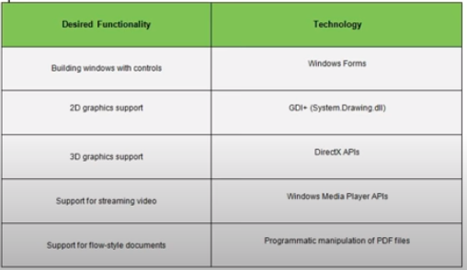

Slide 5
Features of WPF
Some features of WPF include
Data Binding
Dependency Properties Implementation
Styles
Themes
XAML
It enables to decouple code with UI. This enables unit testing in application easier.

Slide 6
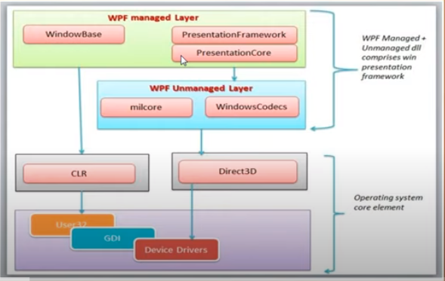
WPF Architecture
WPF architecture is a layered architecture which have Managed, Unmanaged and Core API layers as shown in below fig.

Slide 7
1.Managed Layer
The Presentation Framework, Presentation Core and Window Base are the three major components of the Managed Layer. These are the major code portions of WPF and plays a vital role in an overview of Windows Presentation Foundation. The public API exposed is only via this layer. The Major portion of the WPF is in managed code.
PresentationFramework.dll: This section contains high-level features like application windows, panels, styles controls, layouts, content and so on that helps us to build our application. It also implements the end-user presentation features including data binding, time-dependencies, animations and many more.
PresentationCore.dll: This is a low-level API exposed by WPF providing features for 2D, 3D, geometry and so on. The Presentation Core provides a managed wrapper for MIL and implements the core services for WPF such as UI Element and visual . The Visual System creates visual tree that contains applications Visual Elements and rendering instructions.
WindowsBase.dll: It holds the more basic elements that are capable to be reused outside the WPF environment like Dispatcher objects and Dependency objects.

Slide 8
2.Unmanaged Layer
milCore.dll: The composition engine that renders the WPF application is a native component. It is called the Media Integration Layer (MIL) and resides in milCore.dll. The purpose of the milCore is to interface directly with DirectX and provide basic support for 2D and 3D surface. This section is unmanaged code because it acts as a bridge between WPF managed and the DirectX / User32 unmanaged API.
WindowsCodecs.dll: WindowsCodecs is another low-level API for imaging support in WPF applications like image processing, image displaying and scaling and so on. It consists of a number of codecs that encode/decode images into vector graphics that would be rendered into a WPF screen.

Slide 9
3. Core API Layer
This layer has OS core components like Kernel, User32, GDI, Device Drivers, Graphic cards etc. These components are used by the application to access low level APIs. User32 manages memory and process separation.

Slide 10
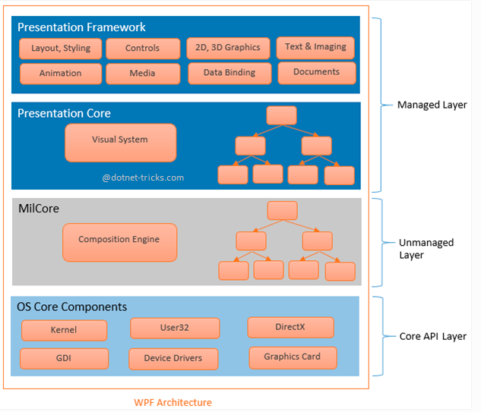
WPF Architecture

Slide 11
What is XAML
Extensible Application Markup Language (XAML) is a declarative markup language.
As applied to the .NET Core programming model, XAML simplifies creating a UI for a .NET Core app.
You can create visible UI elements in the declarative XAML markup, and then separate the UI definition from the run-time logic by using code-behind files that are joined to the markup through partial class definitions.
XAML directly represents the instantiation of objects in a specific set of backing types defined in assemblies. This is unlike most other markup languages, which are typically an interpreted language without such a direct tie to a backing type system. XAML enables a workflow where separate parties can work on the UI and the logic of an app, using potentially different tools.
When represented as text, XAML files are XML files that generally have the .xaml extension.

Slide 12
XAML cont..
XAML is Microsoft’s variant of XML for describing a UI.
XAML code is declared using textual XML. We can use designers to create XAML code or can write this code by hand.
XAML is converted to BAML at runtime by MSBuild.(Binary Application Markup Language)
Every element in a XAML document maps to an instance of a .NET class. The name of the element matches the name of the class exactly.
The xmlns attribute is a specialized attribute in the world of XML that is reserved for declaring namespaces.
The code behind class is generated using partial class concept of C#. This code behind class is responsible for functioning of WPF application.
The properties of classes defined in XAML are specified as attributes.

Slide 13
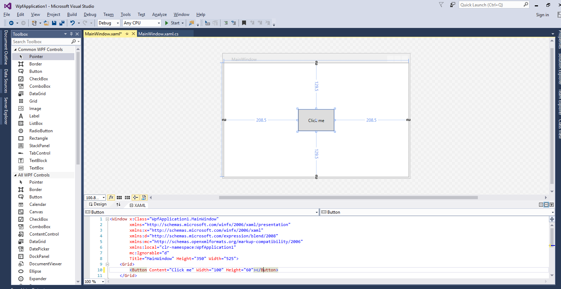
Element data binding

Slide 14
Thankyou
Any question ?

